Slide 1


Displaying Geometric Shapes on Console in
C++

Slide 2


Slide 3


Slide 4
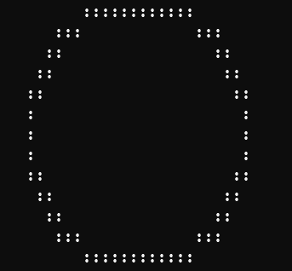
Print Geometric Shapes on Console
In the Lab, you were given the task to print geometric Shapes like a Circle on the Console.
Notes:
After this lecture, you shall be able to explain the Hardware Components (that are input output devices, CPU and memory) and their role while computing any problem.

Slide 5
Print Geometric Shapes on Console
Looking at the output we know that we have to use cout statement and endl statement.
Notes:
After this lecture, you shall be able to explain the Hardware Components (that are input output devices, CPU and memory) and their role while computing any problem.

Slide 6
Print Geometric Shapes on Console
Lets see how we can do that.
Notes:
After this lecture, you shall be able to explain the Hardware Components (that are input output devices, CPU and memory) and their role while computing any problem.

Slide 7
Print Geometric Shapes on Console
This is the C++ structure that we must write in the notepad before writing any cout or endl commands.
#include<iostream>
using namespace std;
main()
{
}
Notes:
After this lecture, you shall be able to explain the Hardware Components (that are input output devices, CPU and memory) and their role while computing any problem.

Slide 8
Print Geometric Shapes on Console
Lets just write the code for a single line first.
#include<iostream>
using namespace std;
main()
{
cout << " :::::::::::: " << endl;
}
Notes:
After this lecture, you shall be able to explain the Hardware Components (that are input output devices, CPU and memory) and their role while computing any problem.

Slide 9
Print Geometric Shapes on Console
Space is given in double quotes of cout statement as this space will be represented on the console.
#include<iostream>
using namespace std;
main()
{
cout << " :::::::::::: " << endl;
}
Notes:
After this lecture, you shall be able to explain the Hardware Components (that are input output devices, CPU and memory) and their role while computing any problem.

Slide 10
Print Geometric Shapes on Console
Now lets see after compiling and executing the program what will be displayed on the Console.
#include<iostream>
using namespace std;
main()
{
cout << " :::::::::::: " << endl;
}
Notes:
After this lecture, you shall be able to explain the Hardware Components (that are input output devices, CPU and memory) and their role while computing any problem.

Slide 11
Print Geometric Shapes on Console
Now lets see after compiling and executing the program what will be displayed on the Console.
#include<iostream>
using namespace std;
main()
{
cout << " :::::::::::: " << endl;
}
Notes:
After this lecture, you shall be able to explain the Hardware Components (that are input output devices, CPU and memory) and their role while computing any problem.

Slide 12

Print Geometric Shapes on Console
Now let’s keep on adding the code and see what is being displayed on the console after each line of code.
#include<iostream>
using namespace std;
main()
{
cout << " :::::::::::: " << endl;
}
Notes:
After this lecture, you shall be able to explain the Hardware Components (that are input output devices, CPU and memory) and their role while computing any problem.

Slide 13
Print Geometric Shapes on Console
#include<iostream>
using namespace std;
main()
{
cout << " :::::::::::: " << endl;
cout << " ::: ::: " << endl;
}
Notes:
After this lecture, you shall be able to explain the Hardware Components (that are input output devices, CPU and memory) and their role while computing any problem.

Slide 14
Print Geometric Shapes on Console
#include<iostream>
using namespace std;
main()
{
cout << " :::::::::::: " << endl;
cout << " ::: ::: " << endl;
cout << " :: :: " << endl;
}
Notes:
After this lecture, you shall be able to explain the Hardware Components (that are input output devices, CPU and memory) and their role while computing any problem.

Slide 15
Print Geometric Shapes on Console
#include<iostream>
using namespace std;
main()
{
cout << " :::::::::::: " << endl;
cout << " ::: ::: " << endl;
cout << " :: :: " << endl;
cout << " :: :: " << endl;
}
Notes:
After this lecture, you shall be able to explain the Hardware Components (that are input output devices, CPU and memory) and their role while computing any problem.

Slide 16
Print Geometric Shapes on Console
#include<iostream>
using namespace std;
main()
{
cout << " :::::::::::: " << endl;
cout << " ::: ::: " << endl;
cout << " :: :: " << endl;
cout << " :: :: " << endl;
cout << " :: :: " << endl;
}
Notes:
After this lecture, you shall be able to explain the Hardware Components (that are input output devices, CPU and memory) and their role while computing any problem.

Slide 17
Print Geometric Shapes on Console
#include<iostream>
using namespace std;
main()
{
cout << " :::::::::::: " << endl;
cout << " ::: ::: " << endl;
cout << " :: :: " << endl;
cout << " :: :: " << endl;
cout << " :: :: " << endl;
cout << " : : " << endl;
}
Notes:
After this lecture, you shall be able to explain the Hardware Components (that are input output devices, CPU and memory) and their role while computing any problem.

Slide 18
Print Geometric Shapes on Console
#include<iostream>
using namespace std;
main()
{
cout << " :::::::::::: " << endl;
cout << " ::: ::: " << endl;
cout << " :: :: " << endl;
cout << " :: :: " << endl;
cout << " :: :: " << endl;
cout << " : : " << endl;
cout << " : : " << endl;
}
Notes:
After this lecture, you shall be able to explain the Hardware Components (that are input output devices, CPU and memory) and their role while computing any problem.

Slide 19
Print Geometric Shapes on Console
#include<iostream>
using namespace std;
main()
{
cout << " :::::::::::: " << endl;
cout << " ::: ::: " << endl;
cout << " :: :: " << endl;
cout << " :: :: " << endl;
cout << " :: :: " << endl;
cout << " : : " << endl;
cout << " : : " << endl;
cout << " : : " << endl;
}
Notes:
After this lecture, you shall be able to explain the Hardware Components (that are input output devices, CPU and memory) and their role while computing any problem.

Slide 20
Print Geometric Shapes on Console
#include<iostream>
using namespace std;
main()
{
cout << " :::::::::::: " << endl;
cout << " ::: ::: " << endl;
cout << " :: :: " << endl;
cout << " :: :: " << endl;
cout << " :: :: " << endl;
cout << " : : " << endl;
cout << " : : " << endl;
cout << " : : " << endl;
cout << " :: :: " << endl;
}
Notes:
After this lecture, you shall be able to explain the Hardware Components (that are input output devices, CPU and memory) and their role while computing any problem.

Slide 21
Print Geometric Shapes on Console
#include<iostream>
using namespace std;
main()
{
cout << " :::::::::::: " << endl;
cout << " ::: ::: " << endl;
cout << " :: :: " << endl;
cout << " :: :: " << endl;
cout << " :: :: " << endl;
cout << " : : " << endl;
cout << " : : " << endl;
cout << " : : " << endl;
cout << " :: :: " << endl;
cout << " :: :: " << endl;
}
Notes:
After this lecture, you shall be able to explain the Hardware Components (that are input output devices, CPU and memory) and their role while computing any problem.

Slide 22
Print Geometric Shapes on Console
#include<iostream>
using namespace std;
main()
{
cout << " :::::::::::: " << endl;
cout << " ::: ::: " << endl;
cout << " :: :: " << endl;
cout << " :: :: " << endl;
cout << " :: :: " << endl;
cout << " : : " << endl;
cout << " : : " << endl;
cout << " : : " << endl;
cout << " :: :: " << endl;
cout << " :: :: " << endl;
cout << " :: :: " << endl;
}
Notes:
After this lecture, you shall be able to explain the Hardware Components (that are input output devices, CPU and memory) and their role while computing any problem.

Slide 23
Print Geometric Shapes on Console
#include<iostream>
using namespace std;
main()
{
cout << " :::::::::::: " << endl;
cout << " ::: ::: " << endl;
cout << " :: :: " << endl;
cout << " :: :: " << endl;
cout << " :: :: " << endl;
cout << " : : " << endl;
cout << " : : " << endl;
cout << " : : " << endl;
cout << " :: :: " << endl;
cout << " :: :: " << endl;
cout << " :: :: " << endl;
cout << " ::: ::: " << endl;
}
Notes:
After this lecture, you shall be able to explain the Hardware Components (that are input output devices, CPU and memory) and their role while computing any problem.

Slide 24
Print Geometric Shapes on Console
#include<iostream>
using namespace std;
main()
{
cout << " :::::::::::: " << endl;
cout << " ::: ::: " << endl;
cout << " :: :: " << endl;
cout << " :: :: " << endl;
cout << " :: :: " << endl;
cout << " : : " << endl;
cout << " : : " << endl;
cout << " : : " << endl;
cout << " :: :: " << endl;
cout << " :: :: " << endl;
cout << " :: :: " << endl;
cout << " ::: ::: " << endl;
cout << " :::::::::::: " << endl;
}
Notes:
After this lecture, you shall be able to explain the Hardware Components (that are input output devices, CPU and memory) and their role while computing any problem.

Slide 25
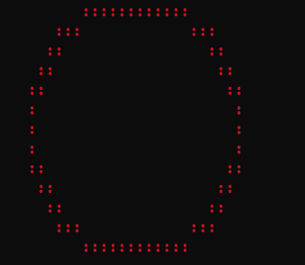
Print Colored Shapes on Console
Now we want to change the color of the circle from white to red.
Notes:
After this lecture, you shall be able to explain the Hardware Components (that are input output devices, CPU and memory) and their role while computing any problem.

Slide 26
Print Colored Shapes on Console
How can we do that?
Notes:
After this lecture, you shall be able to explain the Hardware Components (that are input output devices, CPU and memory) and their role while computing any problem.

Slide 27
Print Colored Shapes on Console
To change the color of the text on the console, we have a command
system("Color XY");
Notes:
After this lecture, you shall be able to explain the Hardware Components (that are input output devices, CPU and memory) and their role while computing any problem.

Slide 28
Print Colored Shapes on Console
To change the color of the text on the console, we have a command
system("Color XY");
Value of X will specify the background Color
Notes:
After this lecture, you shall be able to explain the Hardware Components (that are input output devices, CPU and memory) and their role while computing any problem.

Slide 29
Print Colored Shapes on Console
To change the color of the text on the console, we have a command
system("Color XY");
Value of Y will specify the foreground Text Color.
Notes:
After this lecture, you shall be able to explain the Hardware Components (that are input output devices, CPU and memory) and their role while computing any problem.

Slide 30
Print Colored Shapes on Console
Following are the Possible Values for X and Y.
Color id | Color
1 | Blue
2 | Green
3 | Aqua
4 | Red
5 | Purple
Color id | Color
6 | Yellow
7 | White
8 | Gray
9 | Light Blue
0 | Black
Color id | Color
A | Light Green
B | Light Aqua
C | Light Red
D | Light Purple
E | Light Yellow
F | Bright White
Notes:
After this lecture, you shall be able to explain the Hardware Components (that are input output devices, CPU and memory) and their role while computing any problem.

Slide 31
Print Colored Shapes on Console
For the current problem we want to choose background color (X) of Black and Foreground colour (Y) of Red
Color id | Color
1 | Blue
2 | Green
3 | Aqua
4 | Red
5 | Purple
Color id | Color
6 | Yellow
7 | White
8 | Gray
9 | Light Blue
0 | Black
Color id | Color
A | Light Green
B | Light Aqua
C | Light Red
D | Light Purple
E | Light Yellow
F | Bright White
Notes:
After this lecture, you shall be able to explain the Hardware Components (that are input output devices, CPU and memory) and their role while computing any problem.

Slide 32
Print Colored Shapes on Console
This makes our instruction equal to:
system("Color 04");
Color id | Color
1 | Blue
2 | Green
3 | Aqua
4 | Red
5 | Purple
Color id | Color
6 | Yellow
7 | White
8 | Gray
9 | Light Blue
0 | Black
Color id | Color
A | Light Green
B | Light Aqua
C | Light Red
D | Light Purple
E | Light Yellow
F | Bright White
Notes:
After this lecture, you shall be able to explain the Hardware Components (that are input output devices, CPU and memory) and their role while computing any problem.

Slide 33
Print Colored Shapes on Console
Now, where we have to write the instruction in our previous Code?
#include<iostream>
using namespace std;
main()
{
cout << " :::::::::::: " << endl;
cout << " ::: ::: " << endl;
cout << " :: :: " << endl;
cout << " :: :: " << endl;
cout << " :: :: " << endl;
cout << " : : " << endl;
cout << " : : " << endl;
cout << " : : " << endl;
cout << " :: :: " << endl;
cout << " :: :: " << endl;
cout << " :: :: " << endl;
cout << " ::: ::: " << endl;
cout << " :::::::::::: " << endl;
}
system("Color 04");
Notes:
After this lecture, you shall be able to explain the Hardware Components (that are input output devices, CPU and memory) and their role while computing any problem.

Slide 34
Print Colored Shapes on Console
We will write it before printing anything on the console.
#include<iostream>
using namespace std;
main()
{
cout << " :::::::::::: " << endl;
cout << " ::: ::: " << endl;
cout << " :: :: " << endl;
cout << " :: :: " << endl;
cout << " :: :: " << endl;
cout << " : : " << endl;
cout << " : : " << endl;
cout << " : : " << endl;
cout << " :: :: " << endl;
cout << " :: :: " << endl;
cout << " :: :: " << endl;
cout << " ::: ::: " << endl;
cout << " :::::::::::: " << endl;
}
system("Color 04");
Notes:
After this lecture, you shall be able to explain the Hardware Components (that are input output devices, CPU and memory) and their role while computing any problem.

Slide 35
Print Colored Shapes on Console
Now, our code
becomes:
#include<iostream>
using namespace std;
main()
{
system("Color 04");
cout << " :::::::::::: " << endl;
cout << " ::: ::: " << endl;
cout << " :: :: " << endl;
cout << " :: :: " << endl;
cout << " :: :: " << endl;
cout << " : : " << endl;
cout << " : : " << endl;
cout << " : : " << endl;
cout << " :: :: " << endl;
cout << " :: :: " << endl;
cout << " :: :: " << endl;
cout << " ::: ::: " << endl;
cout << " :::::::::::: " << endl;
}
Notes:
After this lecture, you shall be able to explain the Hardware Components (that are input output devices, CPU and memory) and their role while computing any problem.

Slide 36
Print Colored Shapes on Console
And the output is:
#include<iostream>
using namespace std;
main()
{
system("Color 04");
cout << " :::::::::::: " << endl;
cout << " ::: ::: " << endl;
cout << " :: :: " << endl;
cout << " :: :: " << endl;
cout << " :: :: " << endl;
cout << " : : " << endl;
cout << " : : " << endl;
cout << " : : " << endl;
cout << " :: :: " << endl;
cout << " :: :: " << endl;
cout << " :: :: " << endl;
cout << " ::: ::: " << endl;
cout << " :::::::::::: " << endl;
}
Notes:
After this lecture, you shall be able to explain the Hardware Components (that are input output devices, CPU and memory) and their role while computing any problem.

Slide 37
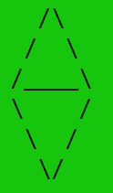
Working Example
Now we want to print this shape on the console.
Notes:
After this lecture, you shall be able to explain the Hardware Components (that are input output devices, CPU and memory) and their role while computing any problem.

Slide 38
Working Example: Solution
Now we want to print this shape on the console.
#include <iostream>
using namespace std;
main() {
system("Color A0");
cout <<" /\ " << endl;
cout <<" / \ " << endl;
cout <<" /____\ " << endl;
cout <<" \ / " << endl;
cout <<" \ / " << endl;
cout <<" \/ " << endl;
}
Notes:
After this lecture, you shall be able to explain the Hardware Components (that are input output devices, CPU and memory) and their role while computing any problem.

Slide 39
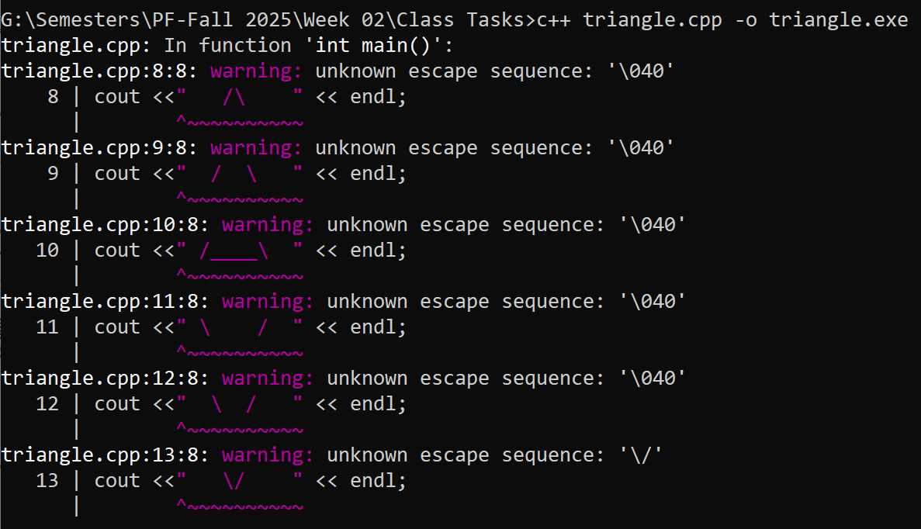
Working Example: Solution
But while running this code we get the following error.
#include <iostream>
using namespace std;
main() {
system("Color A0");
cout <<" /\ " << endl;
cout <<" / \ " << endl;
cout <<" /____\ " << endl;
cout <<" \ / " << endl;
cout <<" \ / " << endl;
cout <<" \/ " << endl;
}
Notes:
After this lecture, you shall be able to explain the Hardware Components (that are input output devices, CPU and memory) and their role while computing any problem.

Slide 40
Working Example: Solution
But while running this code we get the following error.
#include <iostream>
using namespace std;
main() {
system("Color A0");
cout <<" /\ " << endl;
cout <<" / \ " << endl;
cout <<" /____\ " << endl;
cout <<" \ / " << endl;
cout <<" \ / " << endl;
cout <<" \/ " << endl;
}
Notes:
After this lecture, you shall be able to explain the Hardware Components (that are input output devices, CPU and memory) and their role while computing any problem.

Slide 41
Working Example: Solution
Some characters cannot be written directly inside “ ” while displaying output on console, either because:
They are invisible (like newline, tab),
They clash with the syntax (like " itself),
Or they have special meaning (like backslash \).
Notes:
After this lecture, you shall be able to explain the Hardware Components (that are input output devices, CPU and memory) and their role while computing any problem.

Slide 42
Escape Sequences
So, C++ uses escape sequences.
Backslash \ followed by one or more characters, to represent those special characters.
Notes:
After this lecture, you shall be able to explain the Hardware Components (that are input output devices, CPU and memory) and their role while computing any problem.

Slide 43
Escape Sequences
Escape Sequence | Name | Description
\\ | Backslash | Inserts a backslash character.
\" | Double quote | Displays double quotation marks.
\b | Backspace | Moves the cursor one place backward.
\n | New line | Moves the cursor to the start of the next line.
\r | Carriage return | Moves the cursor to the start of the current line.
\t | Horizontal tab | Inserts some whitespace to the left of the cursor and moves the cursor accordingly.
\a | Alert (bell) | Generates a bell sound in the C++ program.
Notes:
After this lecture, you shall be able to explain the Hardware Components (that are input output devices, CPU and memory) and their role while computing any problem.

Slide 44
Working Example: Solution
Now coming back. In order to add backslash we have to enter \\
#include <iostream>
using namespace std;
main() {
system("Color A0");
cout <<" /\\ " << endl;
cout <<" / \\ " << endl;
cout <<" /____\\ " << endl;
cout <<" \\ / " << endl;
cout <<" \\ / " << endl;
cout <<" \\/ " << endl;
}
Notes:
After this lecture, you shall be able to explain the Hardware Components (that are input output devices, CPU and memory) and their role while computing any problem.

Slide 45
Working Example: Solution
Now, the program compiles without any error.
#include <iostream>
using namespace std;
main() {
system("Color A0");
cout <<" /\\ " << endl;
cout <<" / \\ " << endl;
cout <<" /____\\ " << endl;
cout <<" \\ / " << endl;
cout <<" \\ / " << endl;
cout <<" \\/ " << endl;
}
Notes:
After this lecture, you shall be able to explain the Hardware Components (that are input output devices, CPU and memory) and their role while computing any problem.

Slide 46

Learning Objective
Students should be able to use special directives to control output on the screen.
Notes:
After this lecture, you shall be able to explain the Hardware Components (that are input output devices, CPU and memory) and their role while computing any problem.

Slide 47


Conclusion
In C++, to display the numeric and textual output on the monitor screen (console), the available command is cout.
To end the line, we use the endl keyword.
To add color to the Console we have the following command
Here X specifies the Background Color and Y
Specifies the Foreground Color.
Escape sequences are special symbols beginning with a backslash \ that let us represent characters that are otherwise hard to write in cout statement.
system("Color XY");
Notes:
If we adopt Project Based approach for learning programming, and divide our problem into small computational steps, and learn the related Syntax.
Then using this approach we can make our own Games, Websites and Mobile Apps easily.

Slide 48

Self Assessment
What command will be used to change the color of the background to Light Green and foreground color to Purple?
Write the C++ program to make a Triangle with background color of Light Red and Foreground Color of Light Aqua.
Write the C++ program to make a Parallelogram with background color of Light Yellow and Foreground Color of Black.

